Slide 1
A PANORAMA OF SYNTHESIS IN ACADEMIC WRITING

Slide 2
Synthesis in everyday life
The word “synthesis” might seem fancy at first glance but it is something we often make in our everyday lives.
Whenever you report to a friend the things several other friends have said about a film or CD, you engage in synthesis. People synthesize information naturally to help others see the connections between things they learn; for example, you have probably stored up a mental data bank of the various things you've heard about particular professors. If your data bank contains several negative comments, you might synthesize that information and use it to help you decide not to take a class from that particular professor.

Slide 3
Synthesis in academic writing
In academic context, making a synthesis is combining multiple sources or ideas into a whole, making use of the shared qualities between each individual part in order to understand a concept thoroughly.
It searches for meaningful and insightful connections between different materials by the identification of common themes or traits.
It accurately reports information from the sources using different phrases and sentences.

Slide 4
When making a synthesis, you need to…
Read your sources or texts carefully
Understand the problem/matter/issue at hand
Decide from what perspective the sources tackle the issue (What purposes are the sources written for? To inform? To criticize? To defend?)
Select which information to include and not to include in the texts you are given; not all information and sentences work for your paper

Slide 5
To make sure you pick the necessary information from the texts, you should think about:
in what ways the texts overlap
whether they are in the same direction or in opposition
how they stand up for the points they make
whether those points match or correspond to each other
how the texts relate to the overarching aspects or points made in the discussion

Slide 6
Once you have decided which information is appropriate for your paper, highlight key points to easily identify overarching ideas between / among the texts (e.g. arguments and counter-arguments)
Organize your paragraphs in such a way that readers can immediately see where the information from the sources overlap.
Your synthesis should make sense and help the reader understand each point in greater depth.

Slide 7
Towards Writing a Synthesis Paper
STEP 1
Locating and Reporting Information
from Two Different Sources

Slide 8
Identifying Main Ideas and Key Points in Different Sources
Identifying the main ideas and key points in different sources is the first step in the path that will take you to the point where you can write a full synthesis paper.
In this framework (to stand as a starting point), this semester at Advanced English 1 course, you will learn how to locate key points in TWO sources and report them in your own words to compose the body paragraphs of an essay.

Slide 9
Understanding The Final Writing Task in MDB1031
What will be given to you
What you will be asked to do
Read and understand the two sources
Locate the main idea and the key points in each source
Identify how the key points overlap/relate to/counter each other (Remember that the overlapping information might be in different forms such as argument/counter-argument or merit/demerit)
Read the introduction paragraph of the target output
Decide which piece of information to use from the two sources (choose TWO overlapping points)
Write TWO body paragraphs that report two key points of discussion and describe how the two sources relate to/ counter each other
Two sources with differing standpoints on the same topic
The introduction paragraph of an incomplete essay which aims to integrate information from these two sources

Slide 10
Practice
Wind Power

Slide 11
STEP 1: Analyzing the Sources
Examine the two sources on wind power.
The first source is excerpted from a book chapter and the second from a lecture.
The highlighted sections in the two texts are the main ideas and the key points.

Slide 12
Main Idea: wind power as a promising source of energy
Reading 1
Key Point 1:
clean
Key Point 2:
efficient
Key Point 3:
sustainable

Slide 13
Main Idea: wind power as an inadequate solution to energy crisis
Reading 2
Key Point 1:
polluting (noise)
Key Point 2:
inefficient
Key Point 3:
unsustainable

Slide 14
The key points represent shared or overlapping information in the two sources.
The two readings oppose each other. Reading 1 makes a claim about wind power. It includes three supporting reasons. Reading 2 (which is taken from a lecture) challenges this claim with three supporting reasons.

Slide 15
STEP 2: Locating Key Points of Discussion
Source 1 (promoting wind power as an alternative energy source)
Source 2 (rising against the idea that wind power is an adequate solution to energy crisis)
Key Points of Discussion
clean
efficient
sustainable
not clean
inefficient
unsustainable
pollution
efficiency
sustainability
The two sources discuss wind power in terms of pollution, efficiency, and sustainability

Slide 16
STEP 3: Analyzing the Introduction of the Target Output

Slide 17
STEP 4: Writing the Body Paragraphs
For each body paragraph:
Start with a topic sentence – tell the reader which key point of discussion the paragraph will be based on
Report what is argued in the first source by paraphrasing from the original.
Report how the points developed in the first source are countered by the arguments developed in the second by paraphrasing from the original.
Do not forget to use linkers and signpost language appropriately.

Slide 18
BODY PART
PARAGRAPH 1

Slide 19
BODY PART
PARAGRAPH 2

Slide 20
CONCLUSION (Optional)
Note that there is no single format for this essay structure because the structure might change according to how the essay writer makes use of the sources given. However, most synthesis essays have similar body paragraph formats as in this model essay.

Slide 21
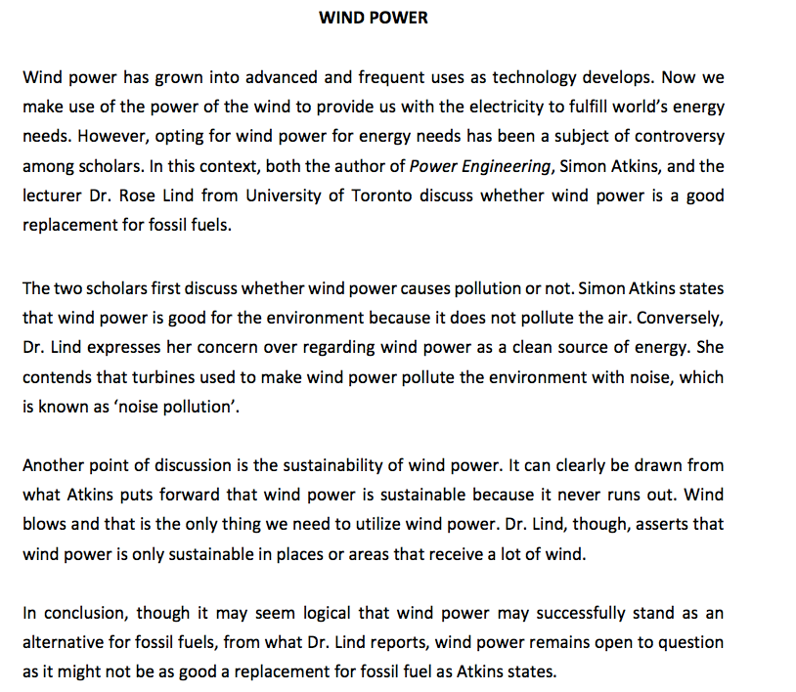

Slide 22
Useful vocabulary & structures to introduce
who does what
Useful vocabulary & structures to introduce
congruent or contrary information/ideas

Slide 23
Specific Structures to be used in the Body Part
The authors/scholars/texts first/also discuss _____.
Another point of discussion is ______.
First of all, the author/lecturer X suggests that ______.
It is mentioned that _____.
This argument is challenged by the author/lecturer Y.
He says _______.
Furthermore, he argues that ______.
Secondly, the writer contends that _____.
The article notes _____.
The lecturer, however, rebuts this by asserting that _____.
She elaborates on this by mentioning that _____.
Finally, it is stated in the article that ____.
The author establishes that _____.
The lecturer, on the other hand, posits that ____.
He puts forth the idea that ____.

